Slide 1
Universal Customer View
Big Data Demonstration
9th - 11th November

Slide 2
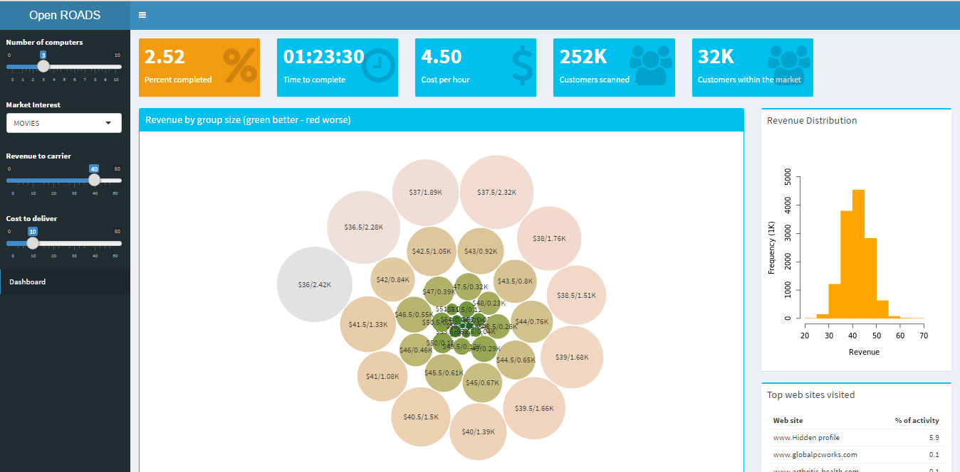
Problem Statement
The real “Top Gear” is coming. How much money can we make after offering free Amazon Prime Video subscriptions?
10M customer CRM records*
100M per service per user records*
External demographic data
Market Interest
Revenue to carrier
Cost to Deliver
Run
Monte Carlo
Simulation
Group customers based
on profit
*Simulated data

Slide 3










Solution Architecture
Microsoft Azure
Data
Storage
Hadoop
Cluster
Controller
UI Shinny
Statistics

